Slide 1
Active Learning for Power Grid Security Classification

Slide 2
Problem & Dataset
Objective: Improve binary classification (secure/insecure) using active learning
Dataset: 8769 simulations (N-1 contingencies)
Features: voltage, loading, power flows
Balanced classes: 4497 (secure), 4272 (insecure)
EDA Highlights:
3 features with missing values
No real time series → simulated time only

Slide 3
Methodology & Setup
Strategies compared: Random, Uncertainty, Entropy, Margin sampling
Setup parameters: initial_size, batch_size, iterations
Splits: Manual Temporal Split and Random Train/Test Split
Evaluation: Final accuracy, mean/std accuracy, time per iteration

Slide 4
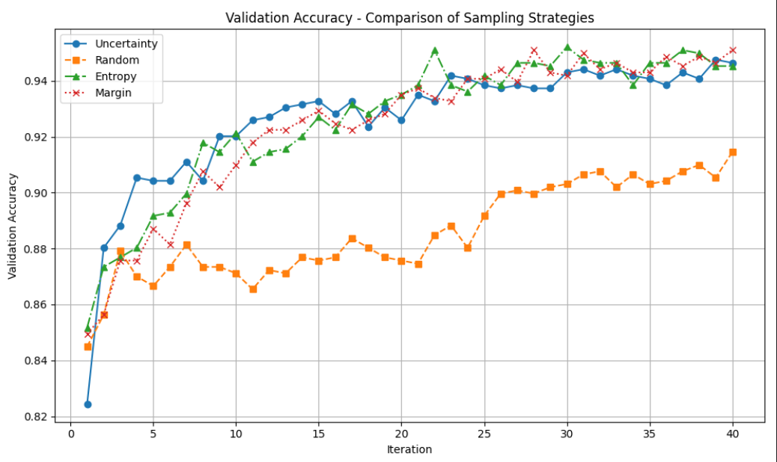
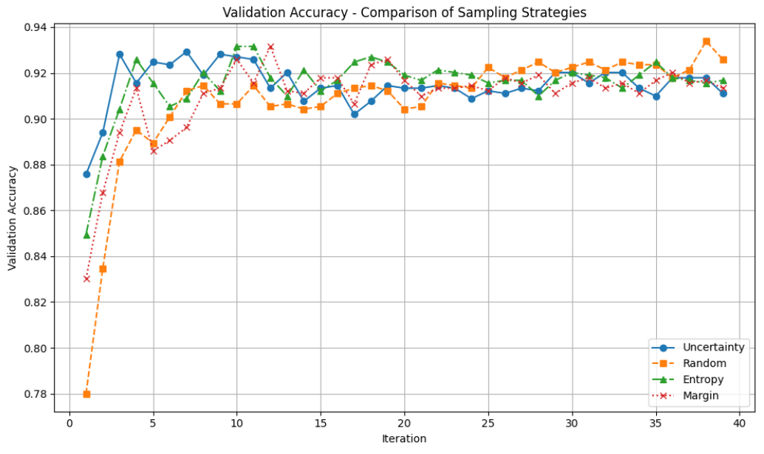
Key results & Takeaways
Best overall (Train/Test Split):
Strategy: Margin
Accuracy: 0.9509
Params: initial_size=100, batch=50, iterations=40
Best (Manual Temporal Split):
Strategy: Random
Accuracy: 0.9259
Params: initial_size=100, batch=100, iterations=40

Slide 5
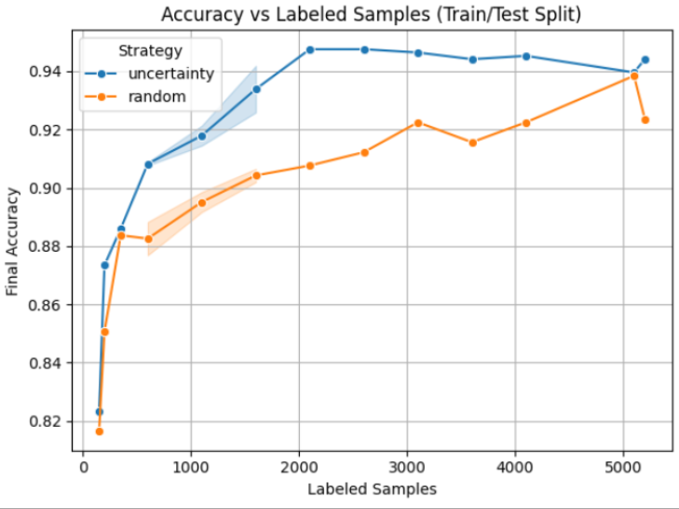
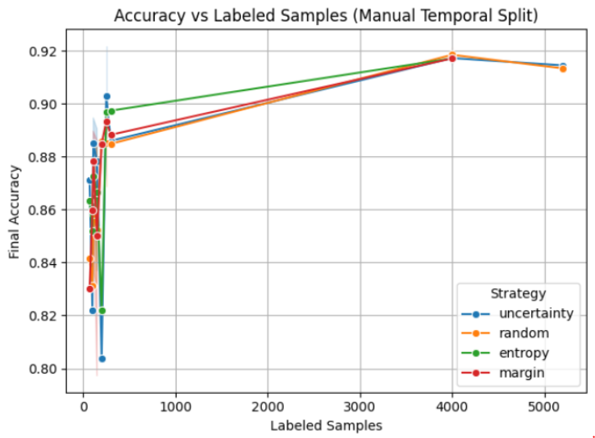
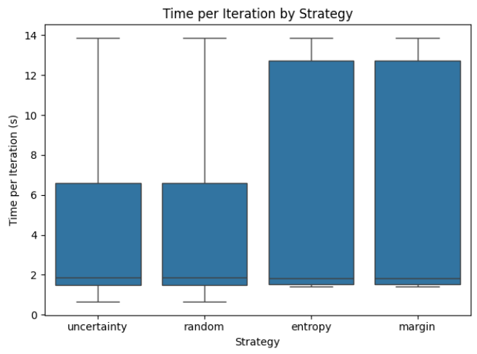
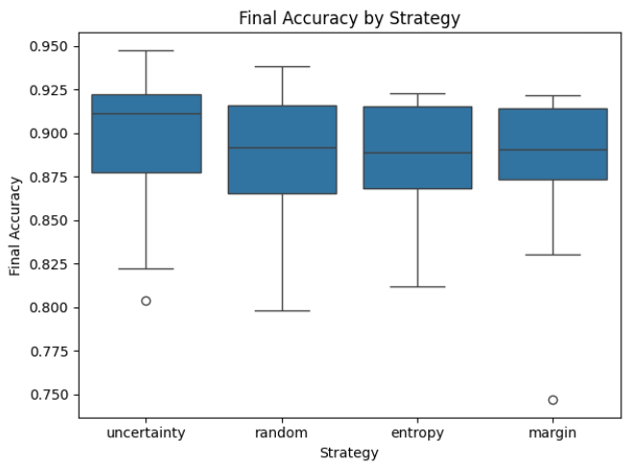
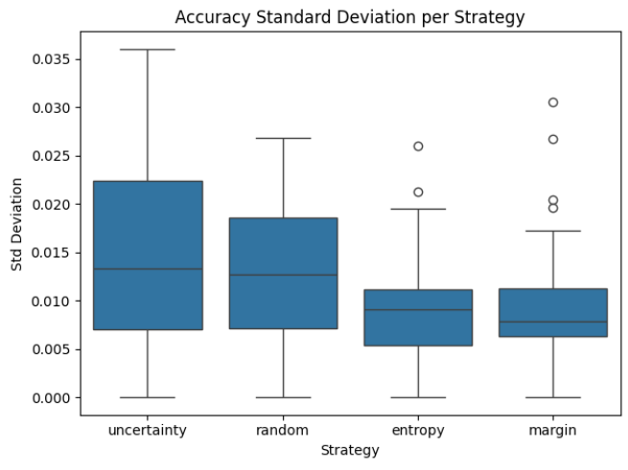
Comparison of Active Learning strategies

